Slide 1
Goal:
Build an app that tracks my time 24 / 7.
That helps me see how I’m wasting time, and how I can improve how I use time.

Slide 2

2.0
1.0
0.5
Phone Icons
Phone Icons
Phone Icons
TIMII
TIMII
TIMII
+
+
+
Name
Name
Name
Name
Name
Name
Name
Name
Name
Name
Name
Name
Dashboard
Dashboard
Dashboard
Message Board
Calendar
To Do Timer
Stats
To Do Timer
To Do Timer
Stats
DB
DB
DB
Jul 1, 2019
Jan 1, 2019
Jul 1, 2018

Slide 3
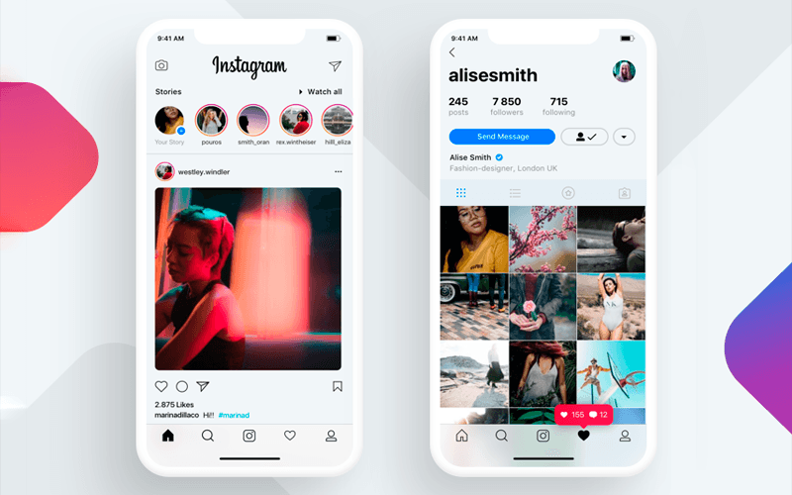

Slide 4
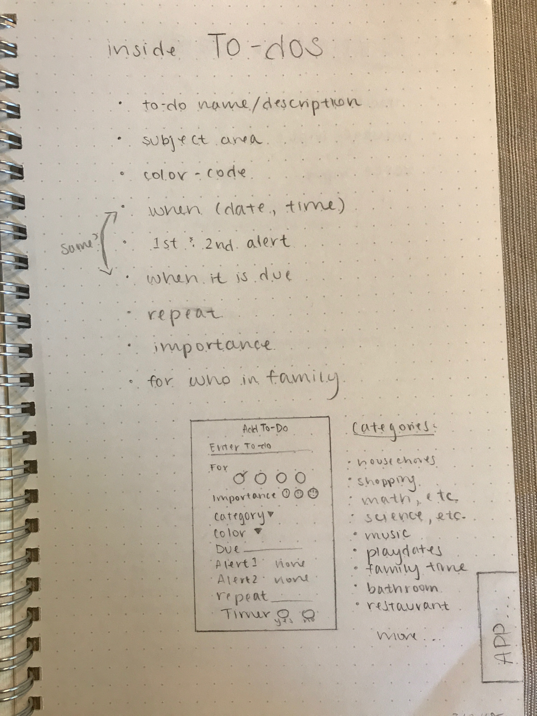
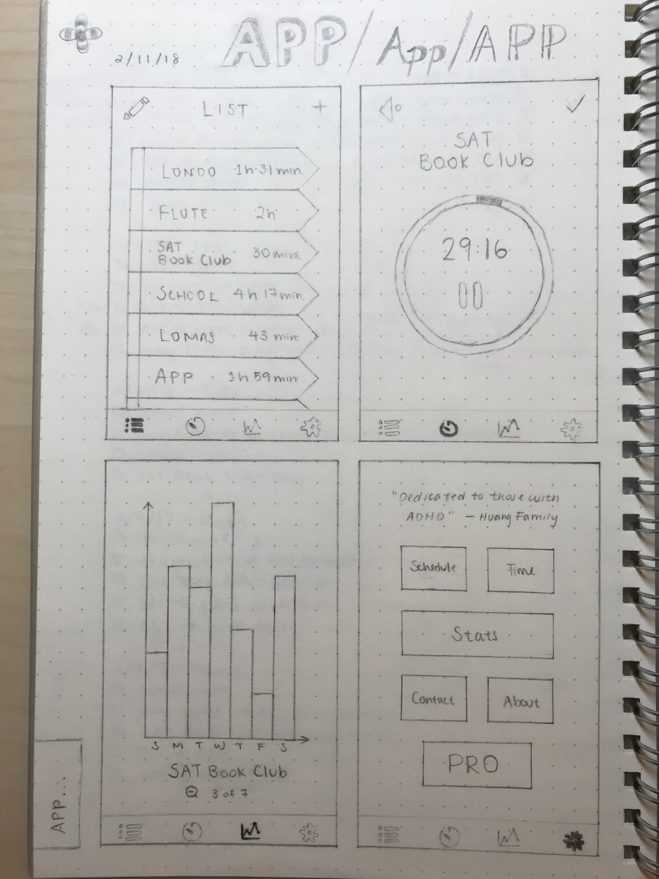
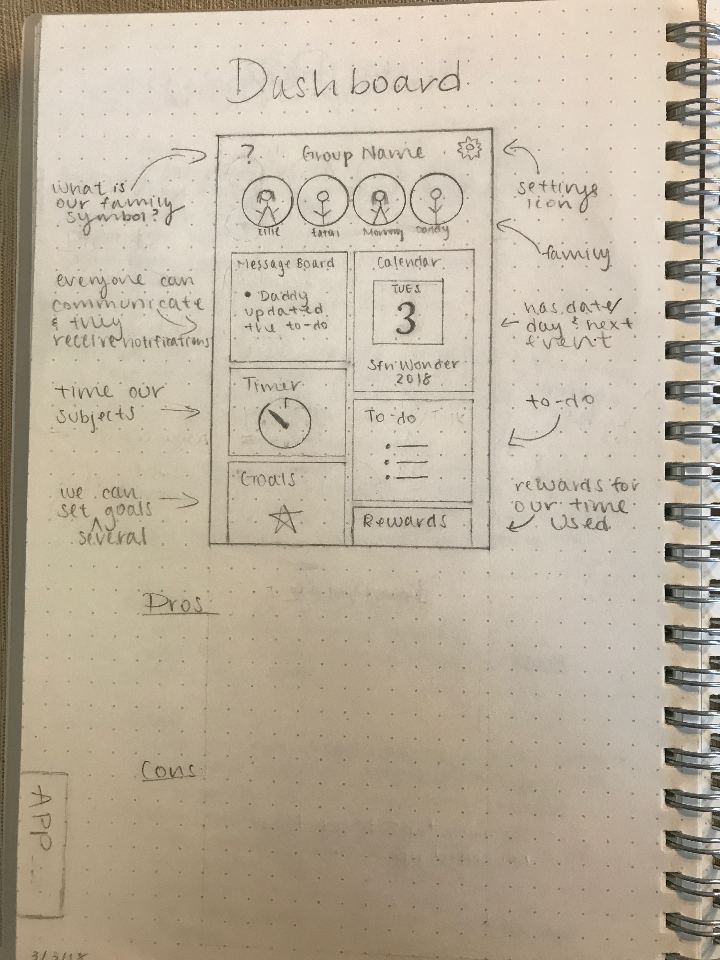
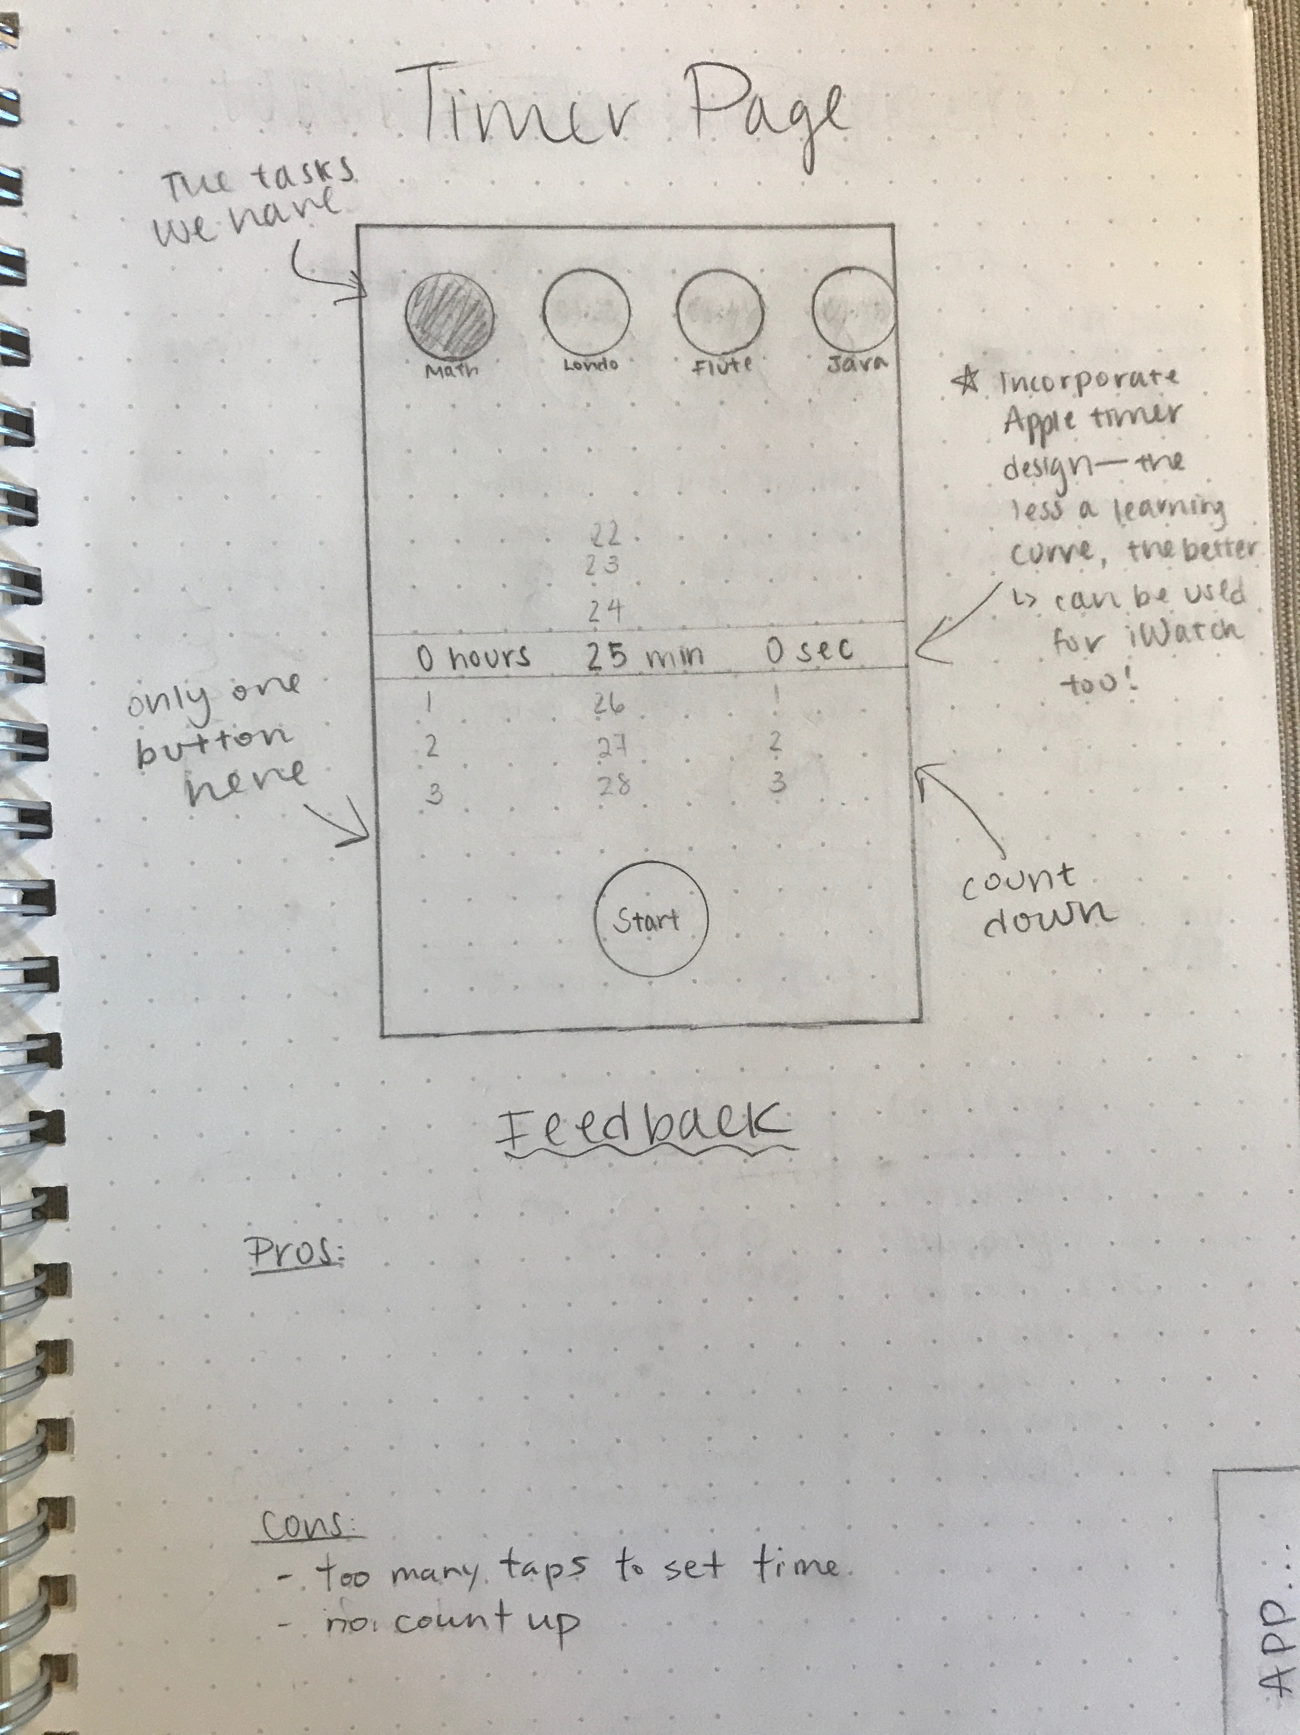

Slide 5
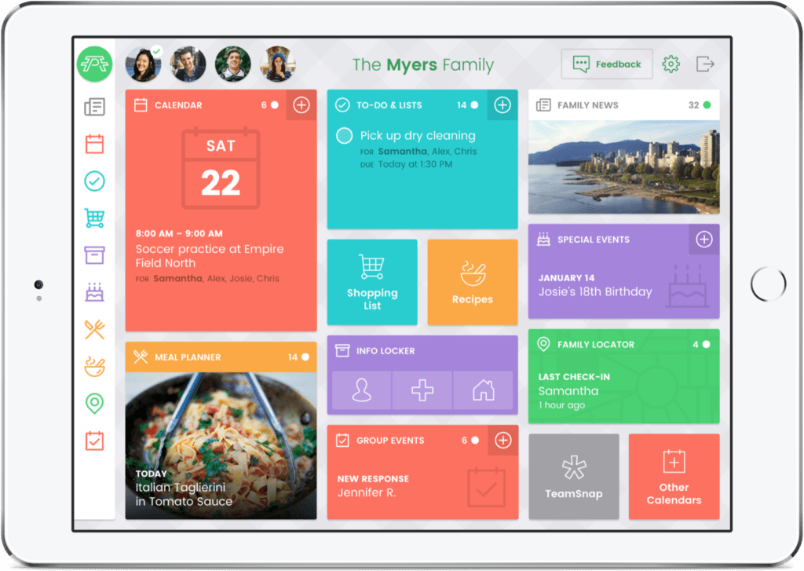
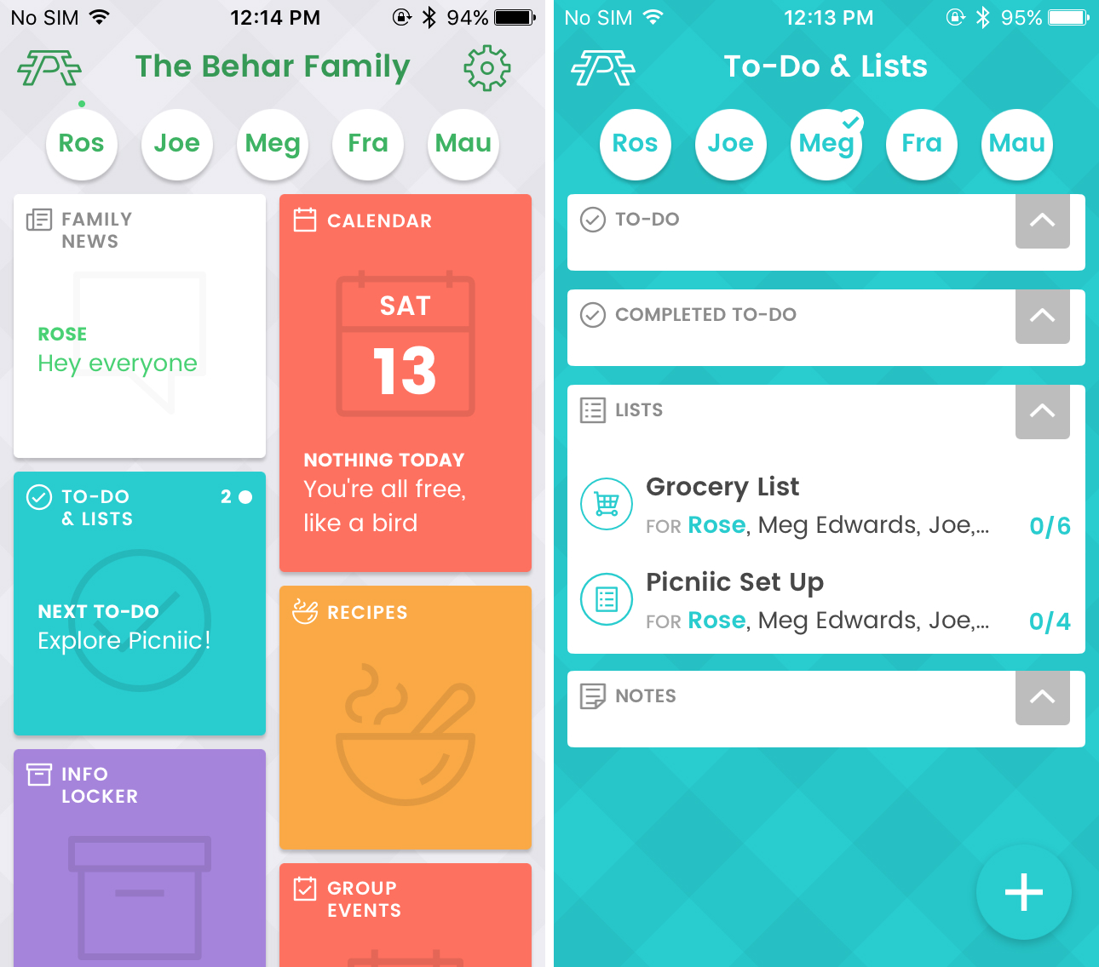
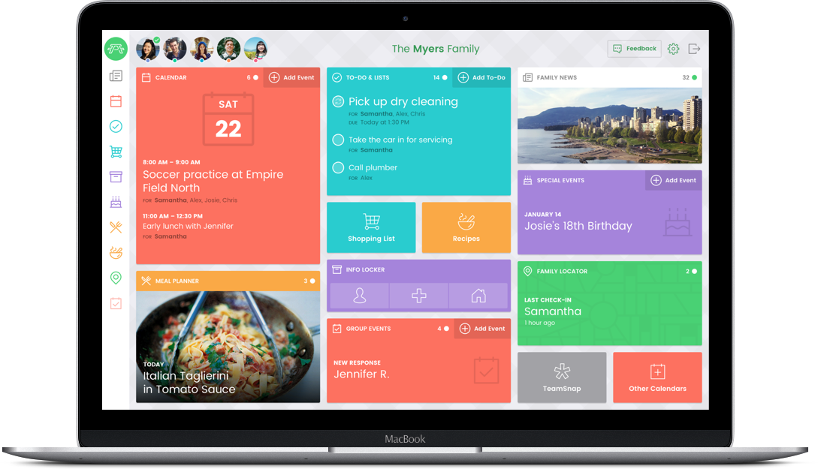

Slide 6
External tools

Slide 7
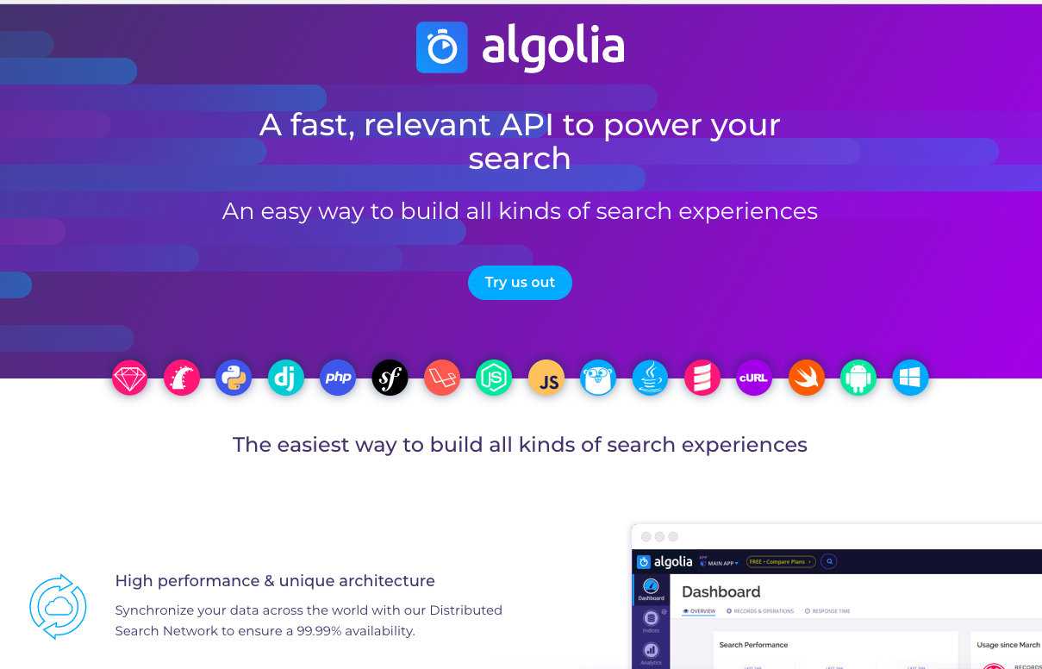
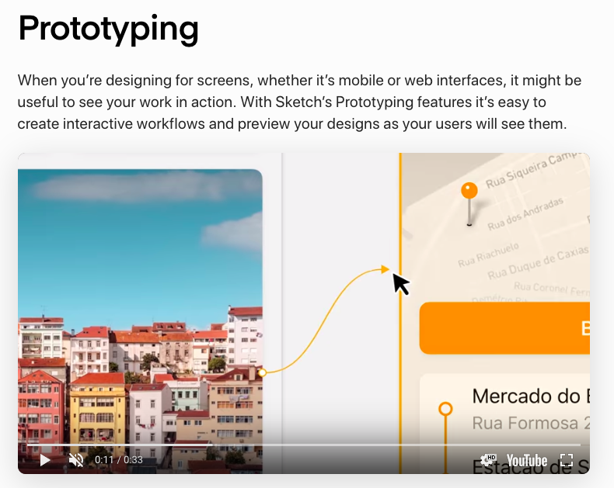
For in APP search
For UI/UX Wireframe and Prototype artwork layout

Slide 8
Archive

Slide 9
2.0
1.0
0.5
Phone Icons
Phone Icons
Phone Icons
Logo
Logo
Logo
People
People
People
+
+
+
Message Board
Calendar
To Do Timer
Message Board
To Do Timer
To Do Timer
Stats
Navigation Footer
Navigation Footer
Navigation Footer
Jul 1, 2019
Jan 1, 2019
Jul 1, 2018

